Slide 1

Chapter 35 MVC and Swing MVC Components

Slide 2
Objectives
To use the model-view-controller approach to separate data and logic from the presentation of data (§35.2).
To implement the model-view-controller components using the JavaBeans event model (§35.2).
To explain the Swing model-view-controller architecture (§35.4).
To use JSpinner to scroll the next and previous values (§35.5).
To create custom spinner models and editors (§35.6).
To use JList to select single or multiple items in a list (§35.7).
To add and remove items using ListModel and DefaultListModel (§35.8).
To render list cells using a default or custom cell renderer (§35.9).
To create custom combo box models and renderers (§35.10).

Slide 3
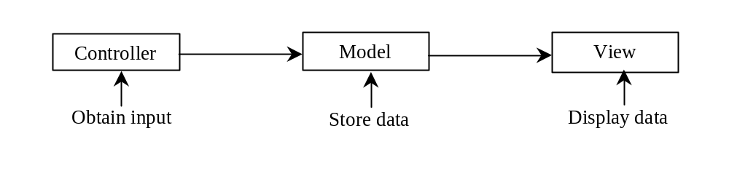
Model-View-Controller (MVC)
The model-view-controller (MVC) approach is a way of developing components by separating data storage and handling from the visual representation of the data. The component for storing and handling data, known as a model, contains the actual contents of the component. The component for presenting the data, known as a view, handles all essential component behaviors. It is the view that comes to mind when you think of the component. It does all the displaying of the components. The controller is a component that is usually responsible for obtaining data.

Slide 4
Benefits of MVC
It makes multiple views possible so that data can be shared through the same model. For example, a model storing student names can simultaneously be displayed in a combo box or in a list box
It simplifies the task of writing complex applications and makes the components scalable and easy to maintain. Changes can be made to the view without affecting the model, and vice versa

Slide 5
Synchronization between Model and View
A model contains data, whereas a view makes the data visible. Once a view is associated with a model, it immediately displays updates to the model. This ensures that all the views of the model display the same data consistently. To achieve consistency and synchronize the model with its dependent views, the model should notify the views when there is a change in a property in the model that is used in the view. In response to a change notification, the view is responsible for redisplaying the viewing area affected by the property change.
The JDK event delegation model provides a superior architecture for supporting MVC component development. The model can be implemented as a source with appropriate event and event listener registration methods. The view can be implemented as a listener. Thus, if data are changed in the model, the view will be notified. To enable the selection of the model from the view, simply add the model as a property in the view with a set method.

Slide 6



Example: Developing Model-View-Controller Components
Problem: The example creates a model named CircleModel, a view named CircleView and a controller named CircleControl. CircleModel stores the properties (radius, filled, and color) that describe a circle. filled is a boolean value that indicates whether a circle is filled. CircleView draws a circle according to the properties of the circle. CircleControl enables the user to enter circle properties from a graphical user interface. Create an applet with two buttons named Show Controller and Show View. When click the Show Controller button, the controller is displayed in a frame. When click the Show View button, the view is displayed in a separate frame.
controller
view

Slide 7
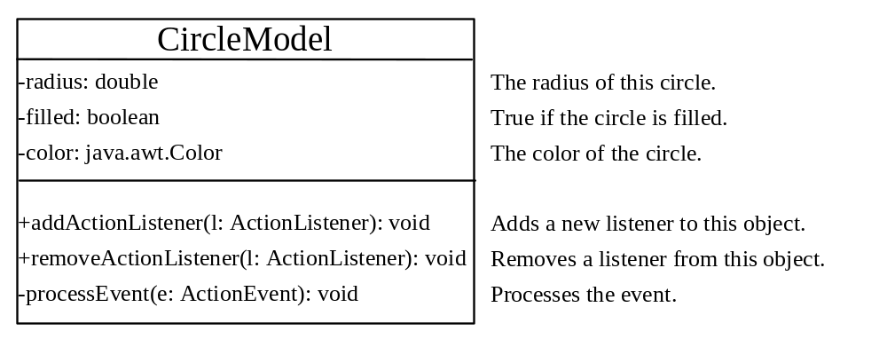
CircleModel
The circle model stores the data and notifies any change of data to the listeners. The circle model contains properties radius, filled, and color, as well as the registration/deregistration methods for action event.
CircleModel

Slide 8
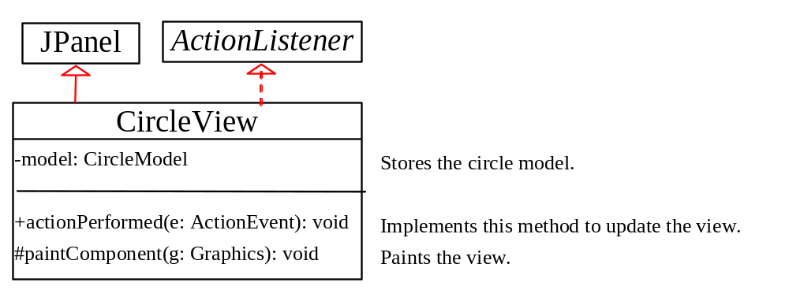
CircleView
The view implements ActionListener to listen for notifications from the model. It contains the model as its property. When a model is set in the view, the view is registered with the model. The view extends JPanel to override the paintComponent method to draw the circle according to the properties values specified in the model.
CircleView

Slide 9
CircleController
The controller presents a GUI interface that enables the user to enter circle properties radius, filled, and color. It contains the model as its property. You can use the setModel method to associate a circle model with the controller. It uses a text field to obtain a new radius and a combo box to obtain a boolean value to specify whether the circle is filled.
CircleController

Slide 10
Putting Things Together
Finally, let us create an applet named MVCDemo with two buttons Show Controller and Show View. The Show Controller button displays a controller in a frame and the Show View button displays a view in a separate frame.
MVCDemo
Run

Slide 11
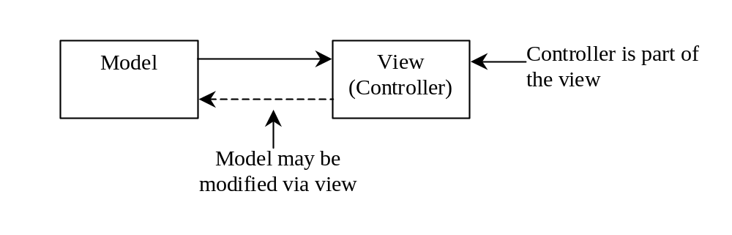
MVC Variations
One variation of the model-view-controller architecture is to combine the controller with the view. In this case, a view not only presents the data, but is also used as an interface to interact with the user and accept user input.
Another variation of the model-view-controller architecture is to add part of the data from the model to the view so that the frequently used data can be accessed directly from the view.

Slide 12
Swing MVC
NOTE: Swing components are designed using the MVC architecture. Each Swing GUI component is a view that uses a model to store data. Many components contain part of the data in the model so that they can be accessed directly from the component.

Slide 13
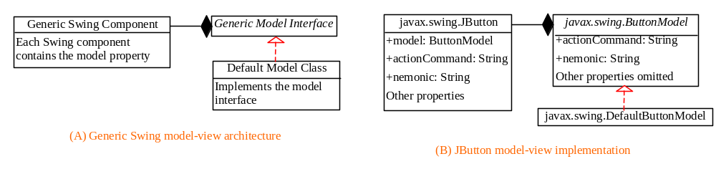
Swing Model-View-Controller Architecture
Each Swing user interface component (except some containers and dialog boxes such as JPanel, JSplitPane, JFileChooser, and JColorChooser) has a property named model that refers to its data model.
The data model is defined in an interface whose name ends with Model. For example, the model for button component is ButtonModel.
Most model interfaces have a default implementation class that is commonly named DefaultX, where X is its model interface name. For example, the default implementation class for ButtonModel is DefaultButtonModel.

Slide 14
Swing Components and Their Models
For convenience, most Swing components contain some properties of their models, and these properties can be accessed and modified directly from the component without knowing the existence of the model. For example, the properties actionCommand and mnemonic are defined in both ButtonModel and JButton. Actually, these properties are in the AbstractButton class. Since JButton is a subclass of AbstractButton, JButton inherits all the properties from AbstractButton.
It is unnecessary to use the models for the simple Swing components such as JButton, JToggleButton, JCheckBox, JRadioButton, JTextField, and JTextArea, because the frequently used properties in their models are also in these components. You can access and modify these properties directly through the components. For advanced components such as JSpinner, JList, JComboBox, JTable, and JTree, you have to work with their models to store, access and modify data.

Slide 15
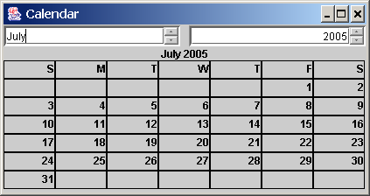
JSpinner
A spinner is a text field with a pair of tiny arrow buttons on its right side that enable the user to select numbers, dates, or values from an ordered sequence. The keyboard up/down arrow keys also cycle through the elements. The user may also be allowed to type a (legal) value directly into the spinner. A spinner is similar to a combo box, but a spinner is sometimes preferred because it doesn't require a drop down list that can obscure important data.

Slide 16
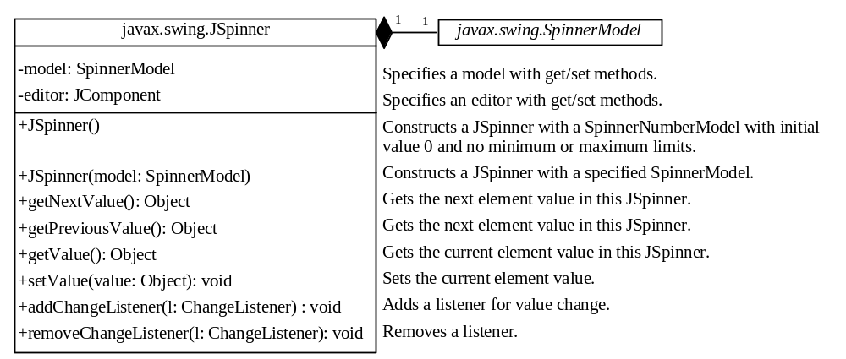
The JSpinner Class
A JSpinner's sequence value is defined by the SpinnerModel interface, which manages a potentially unbounded sequence of elements. The model doesn't support indexed random access to sequence elements. Only three sequence elements are accessible at a time: current, next and previous using the methods getValue(), getNextValue(), and getPreviousValue(), respectively.

Slide 17

Example: A Simple JSpinner Demo
Problem: This example creates a JSpinner object for a sequence of numbers and displays the previous, current, and next number from the spinner on a label.
NOTE: If you create a JSpinner object without specifying a model, the spinner displays a sequence of integers.
SimpleSpinner
Run

Slide 18
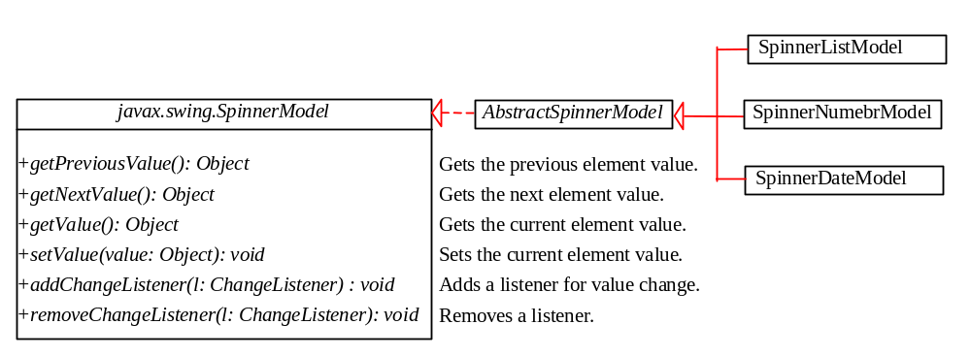
Spinner Models
SpinnerModel is an interface for all spinner models. AbstractSpinnerModel is a convenience abstract class that implements SpinnerModel and provides the implementation for the registration/deregistration methods. SpinnerListModel, SpinnerNumberModel, and SpinnerDateModel are concrete implementations of SpinnerModel.

Slide 19
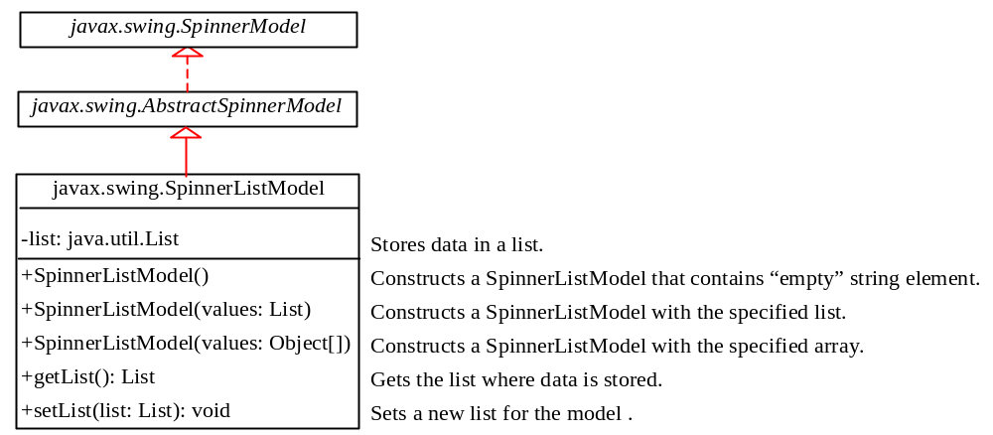
SpinnerListModel
SpinnerListModel is a simple implementation of SpinnerModel whose values are stored in a java.util.List.

Slide 20
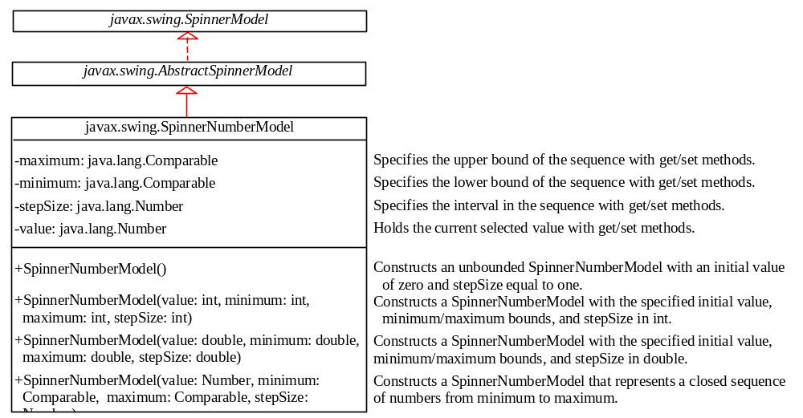
SpinnerNumberModel
SpinnerNumberModel is a concrete implementation of SpinnerModel that represents a sequence of numbers. It contains the properties maximum, minimum, and stepSize.

Slide 21
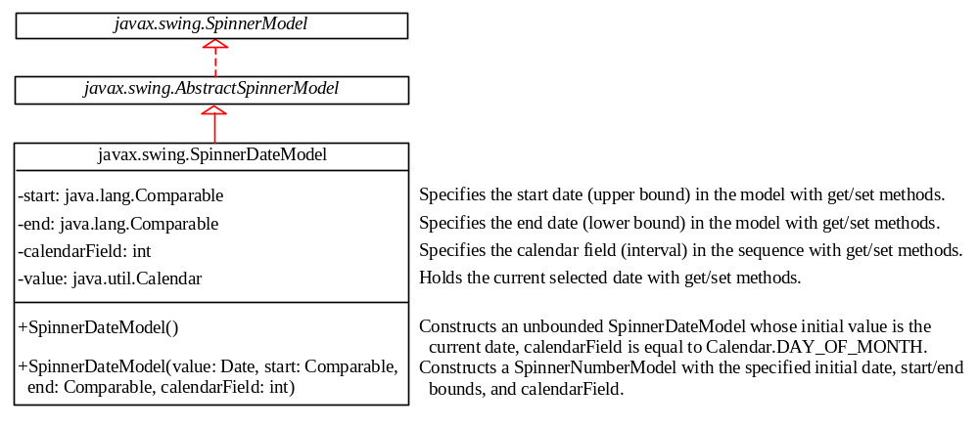
SpinnerDateModel
SpinnerDateModel is a concrete implementation of SpinnerModel that represents a sequence of dates. The upper and lower bounds of the sequence are defined by properties called start and end and the size of the increase or decrease computed by the nextValue and previousValue methods is defined by a property called calendarField.

Slide 22
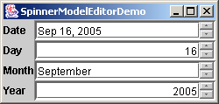
Example: Using Spinner Models and Editors
Problem: This example uses a JSpinner component to display date and three separate JSpinner components to display day in a sequence of numbers, month in a sequence of strings, and year in a sequence of numbers. All these four components are synchronized. For example, if you change year in the spinner for year, the date value in the date spinner is updated accordingly.
SpinnerModelEditorDemo
Run

Slide 23
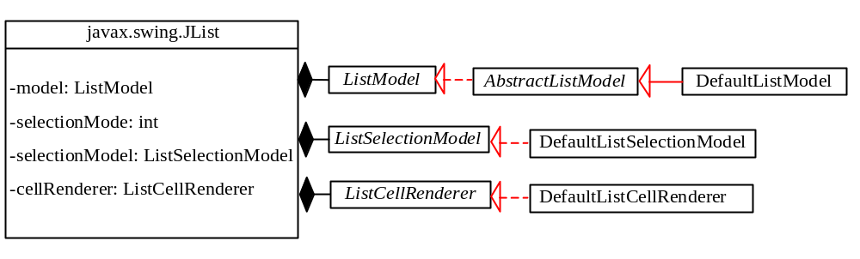
JList
JList has two supporting models: a list model and a list-selection model. The list model is for storing and processing data. The list-selection model is for selecting items. By default, items are rendered as strings or icons. You can also create a custom renderer implementing the ListCellRenderer interface.

Slide 24
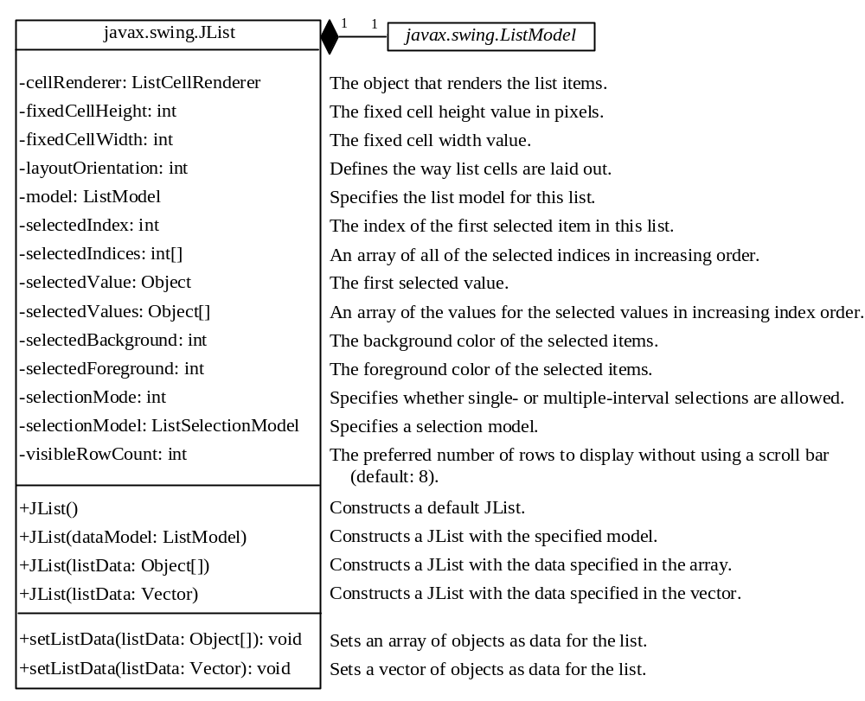
The JList Class

Slide 25
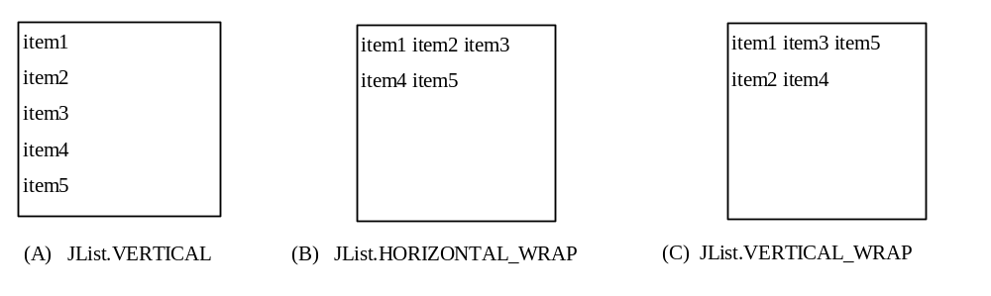
The layoutOrientation property
JList jlst = new JList();
jlst.setLayoutOrientation(int);

Slide 26
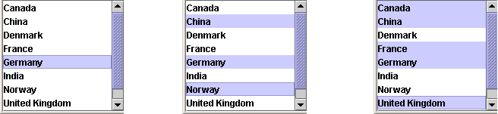
The selectionMode property
JList jlst = new JList();
jlst.setSelectionMode(int);
JList.SINGLE_SELECTION
JList.SINGLE_INTERVAL_SELECTION
JList.MULTIPLE_INTERVAL_SELECTION

Slide 27
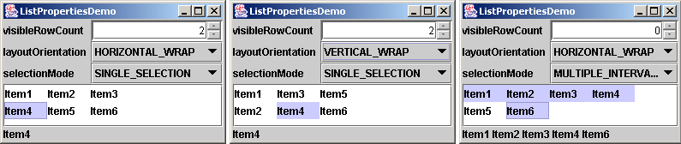
Example: List Properties Demo
Problem: This example creates a list of a fixed number of items displayed as strings. The example enables you to dynamically set visibleRowCount from a spinner, layoutOrientation from a combo box, and selectionMode from a combo box. When you select one or more items, their values are displayed in a status label below the list.
ListPropertiesDemo
Run

Slide 28
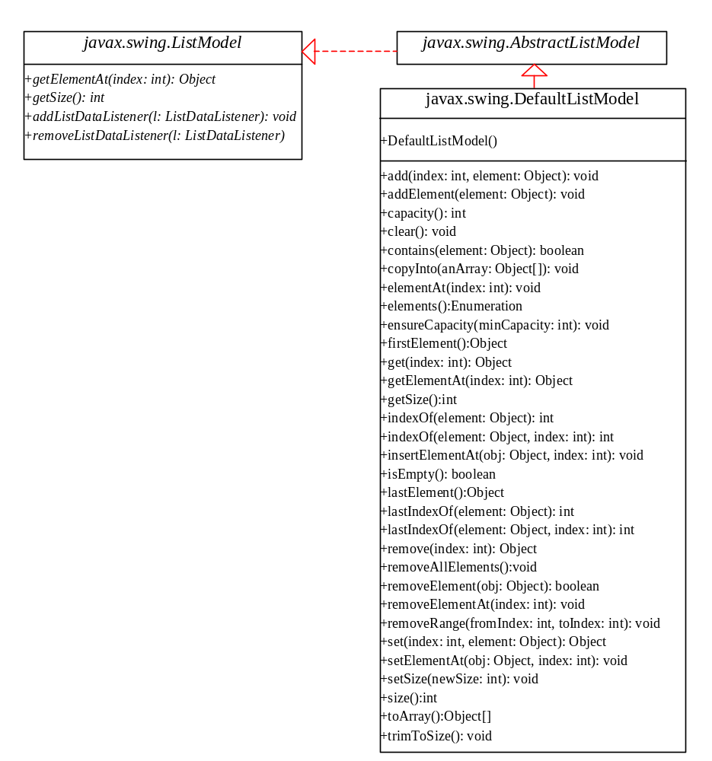
List Models
The JList class delegates the responsibilities of storing and maintaining data to its data model. The JList class itself does not have methods for adding or removing items from the list. These methods are supported in ListModel.
AbstractListModel implements the registration methods in the ListModel, but does not implement the getSize and getElementAt methods.
DefaultListModel extends AbstractListModel and implements the two methods getSize and getElementAt, which are not implemented by AbstractListModel.

Slide 29
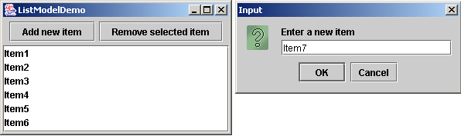
Example: List Model Demo
Problem: This example creates a list using a list model and allows the user to add and delete items in the list. When the user clicks the Add new item button, an input dialog box is displayed to receive a new item.
ListModelDemo
Run

Slide 30
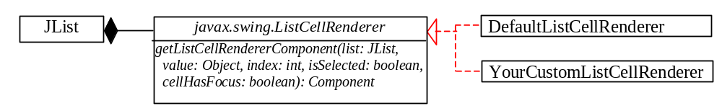
List Cell Renderer
In addition to delegating data storage and processing to list models, JList delegates the rendering of the list cells to list cell renderers.
By default, JList uses DefaultListCellRenderer to render its cells. The DefaultListCellRenderer class implements ListCellRenderer, extends JLabel, and can display either a string or an icon, but not both in the same cell.
All list cell renderers implement the ListCellRenderer interface, which defines a single method, getListCellRendererComponent, as follows
You can create a custom renderer by implementing ListCellRenderer.

Slide 31
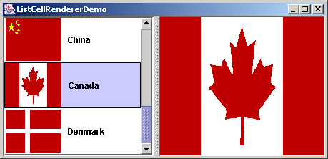
Example: List Cell Renderer Demo
Problem: This example creates a list of countries and displays the country flags and country names in the list. When a country is selected in the list, its flag is displayed in a panel next to the list.
MyListCellRenderer
ListCellRendererDemo
Run

Slide 32
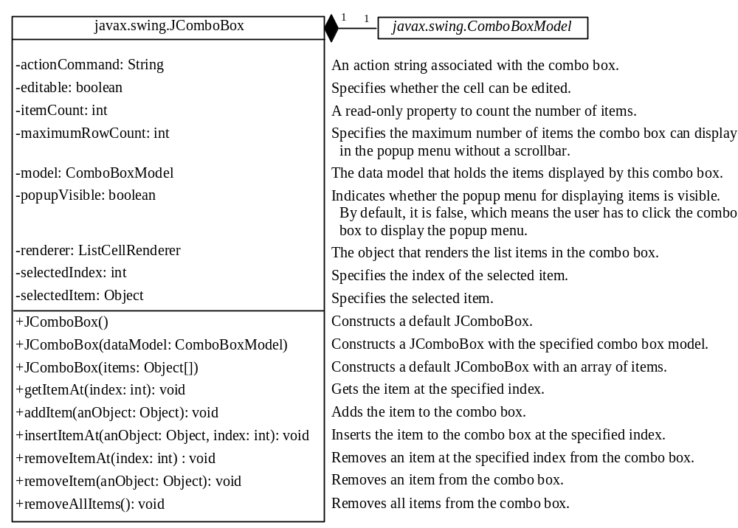
JComboBox

Slide 33
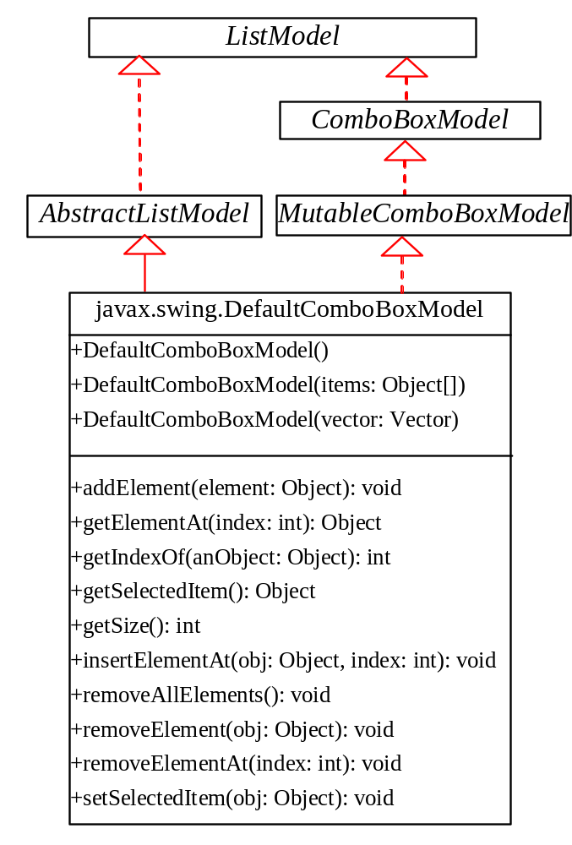
Combo Box Model
JComboBox delegates the responsibilities of storing and maintaining data to its data model. All combo box models implement the ComboBoxModel interface, which extends the ListModel interface and defines the getSelectedItem and setSelectedItem methods for retrieving and setting a selected item.
The methods for adding and removing items are defined in the MutableComboBoxModel interface
DefaultComboBoxModel provides a concrete implementation for ComboModel.

Slide 34
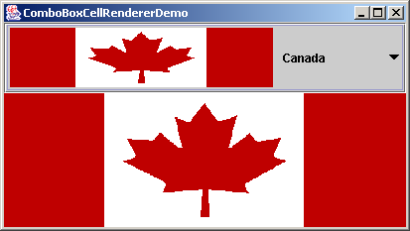
Example: Combo Box Cell Renderer Demo
Problem: This example creates a combo box that contains a list of countries and displays the country flags and country names in the list cell. When a country is selected in the list, its flag is displayed in a panel below the combo box.
ComboBoxCellRenderer
Run

